Slide 1
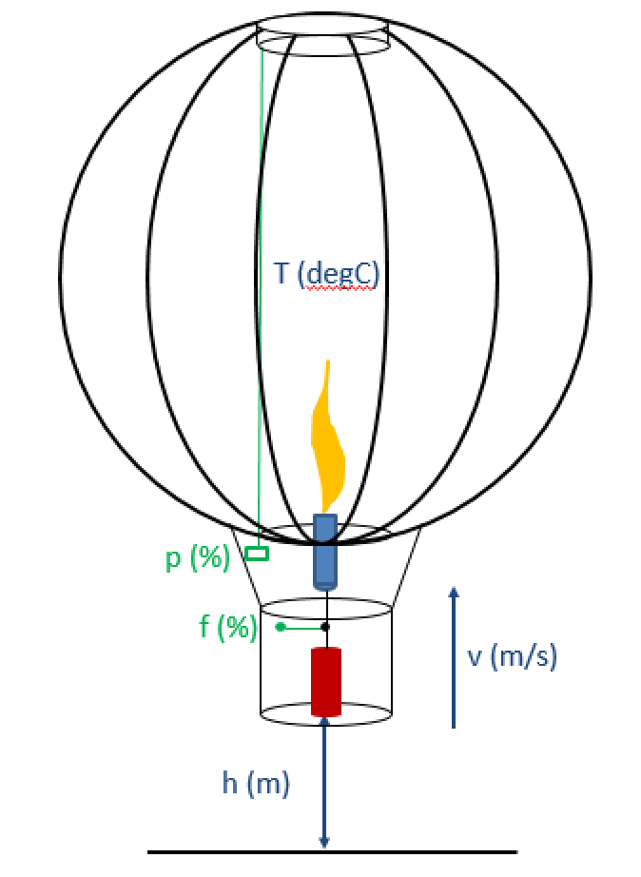

Dynamic Simulation
of a
Hot Air Balloon
Thomas A. Badgwell
Corporate Strategic Research
ExxonMobil Research & Engineering
August 1, 2017

Slide 2
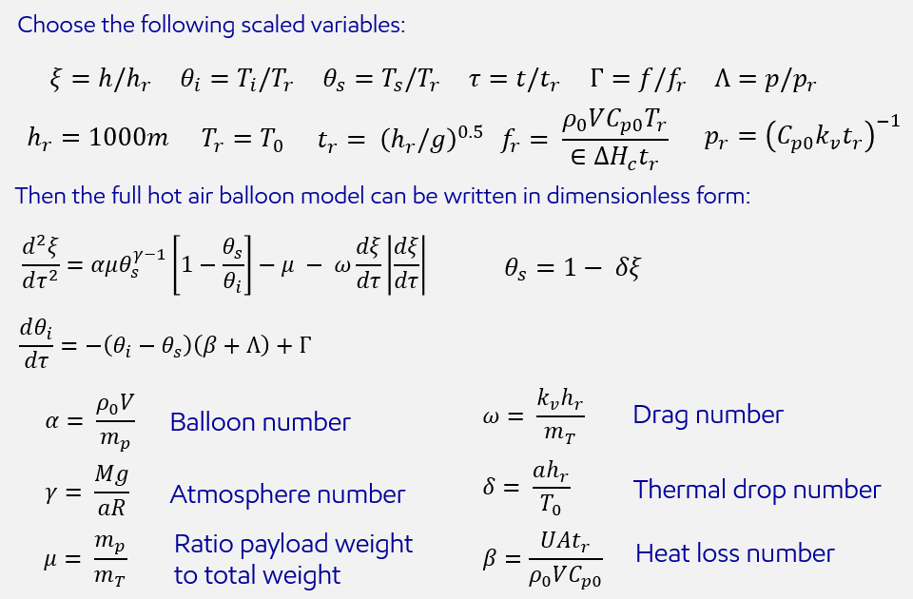
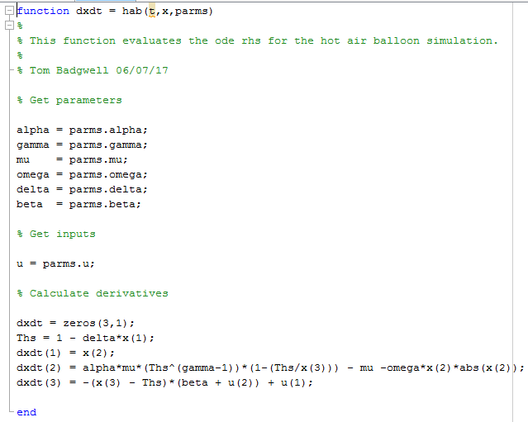
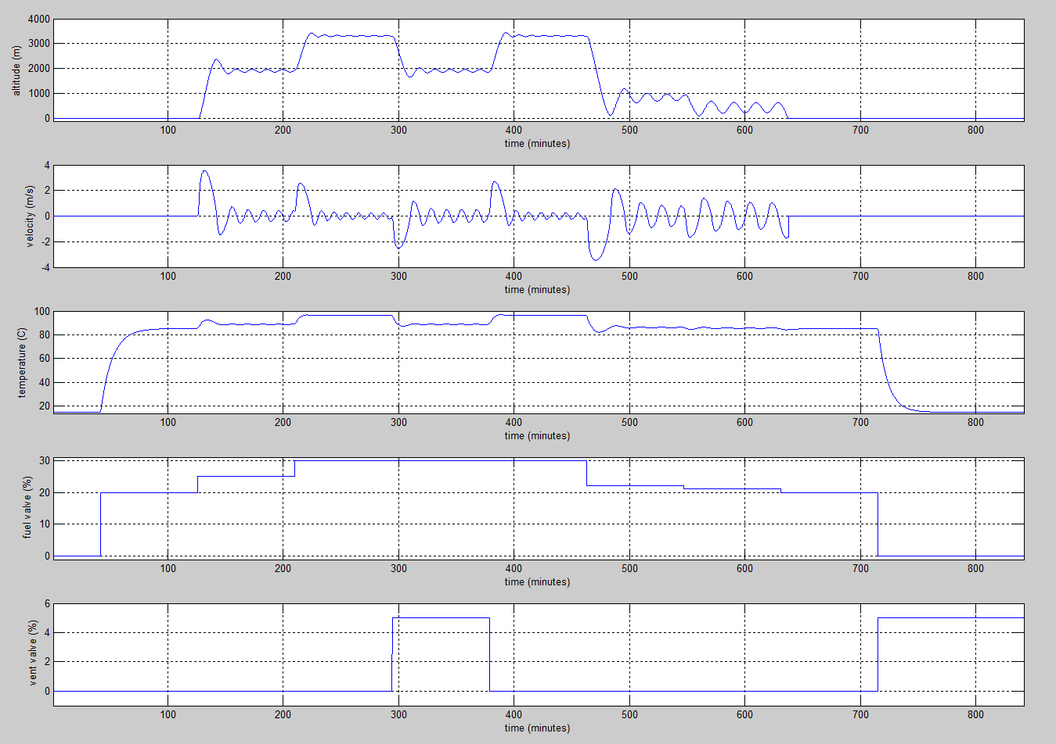
Outline
Model development
Matlab code
Simulation results

Slide 3
Hot Air Balloons were the first manned flying machines
Model development
List key model assumptions
Derive model equations (from assumptions)
Scale the variables to develop a dimensionless model
Facilitates analysis
Simplifies numerical solution
Analyze the model
Determine operating region
Verify good behavior over the operating region (no singularities, exploding exponentials, etc.
Work through an example
Provides a sanity check on model assumptions and analysis
Iterate

Slide 4

Hot Air Balloons were the first manned flying machines
Model development: Modeling assumptions
We focus on vertical movement of the balloon, which can be controlled by the fuel valve position $f$ and vent valve position$p$.
Vertical velocity $v$ depends on lift, weight, and drag forces.
Lift force is equal to the weight of the air displaced by the envelope (Archimedes’ principle).
Drag force is proportional to the square of velocity.
Air is an ideal gas, and atmospheric temperature falls off linearly with altitude [1].
The envelope interior is isothermal at temperature $T_{i}$.
Envelope volume $V$ is constant, and pressure inside and outside the envelope is the same.
The envelope interior temperature $T_{i}$ changes based on fuel valve position $f$, vent valve position$p$, and heat loss to the atmosphere.
The internal energy of the gas in the envelope dominates (over its kinetic and potential energy).
Changes in the internal energy of the gas in the envelope due to pressure changes can be ignored.

Slide 5





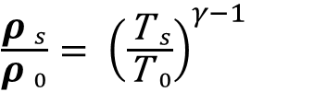

Hot Air Balloons were the first manned flying machines
Model components: Standard Atmosphere [1]
Air is an ideal gas
Atmospheric temperature falls off linearly with altitude, up to 11km
$$P_{s}=\frac{ρ_{s}RT_{s}}{M}$$
$M=$ 28.97 g/mol
$$T_{s}=T_{o}−ah$$
$a=$ 6.5 x ${\text{10}}^{−3}$
$\frac{{\text{ρ} }_{s}}{{\text{ρ} }_{0}}= {\left(\frac{{\text{T} }_{s}}{{\text{T} }_{0}}\right)}^{γ−1 }$
$γ=\frac{gM}{aR}=\frac{\left(.02897 kg/mol\right)\left(9.807 m/s^{2}\right)}{\left(6.5 x {10}^{−3}K/m\right)\left(8.314 J/molK \right)}$ = 5.257
$\frac{{\text{P} }_{s}}{{\text{P} }_{0}}= {\left(\frac{{\text{P} }_{s}}{{\text{P} }_{0}}\right)}^{γ }$

Slide 6


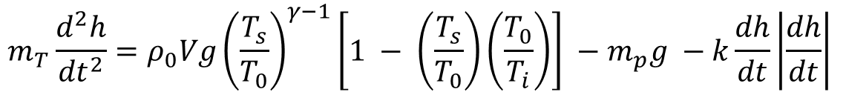
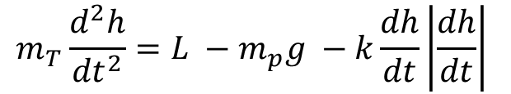
Hot Air Balloons were the first manned flying machines
Model components: Vertical Force Balance
The vertical force balance considers lift, weight, and drag:
$$m_{T}\frac{d^{2}h}{{dt}^{2}}=L −m_{p}g −k\frac{dh}{dt}\left|\frac{dh}{dt}\right|$$
Lift force is given by Archimedes’ principle: The lift force is equal to the weight of the air displaced by the envelope:
$$L=\left(ρ_{s}−ρ_{i}\right)Vg$$
Requirement for air pressure to be the same on the inside and outside of the envelope gives:
$$ρ_{i}=ρ_{s}\left(\frac{T_{s}}{T_{i}}\right)$$
Combining these with the standard atmosphere model gives the following vertical force balance :
$$m_{T}\frac{d^{2}h}{{dt}^{2}}=ρ_{0}Vg{\left(\frac{T_{s}}{T_{0}}\right)}^{γ−1}\left[1 − \left(\frac{T_{s}}{T_{0}}\right)\left(\frac{T_{0}}{T_{i}}\right)\right] −m_{p}g −k\frac{dh}{dt}\left|\frac{dh}{dt}\right|$$

Slide 7

Hot Air Balloons were the first manned flying machines
Model development: Envelope energy balance
The envelope energy balance considers energy input from burning fuel, energy output from venting gas, and heat loss to the atmosphere:
$$\frac{d}{dt}\left(E_{i}\right)=−UA\left(T_{s}−T_{i}\right)−C_{pi}\left(T_{i}−T_{s}\right)k_{v}p$$
Now we make some simplifying assumptions regarding energy changes of the gas in the envelope:
The internal energy of the gas in the envelope dominates (over its kinetic and potential energy).
Changes in the internal energy of the gas in the envelope due to pressure changes can be ignored.
These assumptions allow us to approximate the envelope energy balance as follows:
$$ρ_{0}VC_{p0}\frac{d}{dt}T_{i}=−UA\left(T_{i}−T_{s}\right)+ ∈∆H_{c}f −C_{p0}\left(T_{i}−T_{s}\right)k_{v}p$$

Slide 8



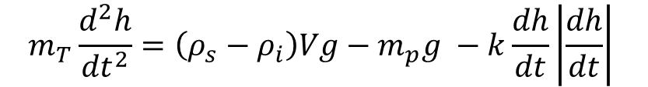

Hot Air Balloons were the first manned flying machines
Hot Air Balloon Model: Dimensional Equations
Standard model of the atmosphere:
$$P_{s}=\frac{ρ_{s}RT_{s}}{M}$$
$M=$ 28.97 g/mol
$$T_{s}=T_{o}−ah$$
$a=$ 6.5 x ${\text{10}}^{−3}$
Vertical force balance:
$$m_{T}\frac{d^{2}h}{{dt}^{2}}=\left(ρ_{s}−ρ_{i}\right)Vg−m_{p}g −k\frac{dh}{dt}\left|\frac{dh}{dt}\right|$$
Energy balance:
$$ρ_{0}VC_{p0}\frac{d}{dt}T_{i}=−UA\left(T_{i}−T_{s}\right)+ ∈∆H_{c}f −C_{p0}\left(T_{i}−T_{s}\right)k_{v}p$$

Slide 9
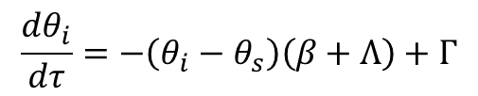


















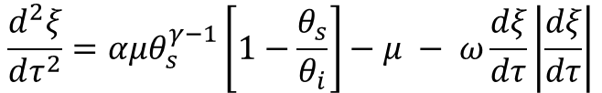
Hot Air Balloons were the first manned flying machines
Dimensionless Hot Air Balloon Model
Choose the following scaled variables:
$$ξ=h/h_{r}$$
$$θ_{i}=T_{i}/T_{r}$$
$$θ_{s}=T_{s}/T_{r}$$
$$τ=t/t_{r}$$
$$Γ=f/f_{r}$$
$$Λ=p/p_{r}$$
$$f_{r}= \frac{ρ_{0}VC_{p0}T_{r}}{∈∆H_{c}t_{r}}$$
$$p_{r}={\left(C_{p0}k_{v}t_{r}\right)}^{−1}$$
$$h_{r}=1000m$$
$$T_{r}=T_{0}$$
$$t_{r}= {\left(h_{r}/g\right)}^{0.5}$$
Then the full hot air balloon model can be written in dimensionless form:
$$\frac{d^{2}ξ}{dτ^{2}}=αμθ_{s}^{γ−1}\left[1−\frac{θ_{s}}{θ_{i}}\right]−μ − ω\frac{dξ}{dτ}\left|\frac{dξ}{dτ}\right|$$
$$θ_{s}=1− δξ$$
$$\frac{dθ_{i}}{dτ}=−\left(θ_{i}−θ_{s}\right)\left(β+Λ\right)+Γ$$
$$α= \frac{ρ_{0}V}{m_{p}}$$
$$ω= \frac{k_{v}h_{r}}{m_{T}}$$
Drag number
Balloon number
$$γ= \frac{Mg}{aR}$$
$$δ= \frac{ah_{r}}{T_{0}}$$
Thermal drop number
Atmosphere number
$$μ= \frac{m_{p}}{m_{T}}$$
Ratio payload weight to total weight
$$β=\frac{UAt_{r}}{ρ_{0}VC_{p0}}$$
Heat loss number

Slide 10







Hot Air Balloons were the first manned flying machines
Dimensionless Hot Air Balloon Model: Takeoff Condition
From the vertical force balance, the condition for takeoff is:
$$\frac{d^{2}ξ}{dτ^{2}}=\frac{dξ}{dτ}=0$$
$$θ_{s}=1$$
$$αμ\left[1−\frac{1}{θ_{i}}\right]≥μ$$
$$θ_{i}≥\frac{∝}{∝−1}$$
for takeoff
Implication is:
$$∝ ≥1$$
$$→$$
$$ρ_{0}V≥m_{p}$$

Slide 11

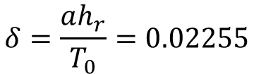
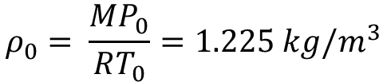




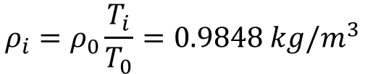



Example: AX7-77 Balloon Model Parameters
Hot Air Balloons were the first manned flying machines
The takeoff takes place at STP (15 degC and 1 atm):
$$ρ_{0}= \frac{MP_{0}}{RT_{0}}=1.225 kg/m^{3}$$
$$∝ =5.098$$
The conditions at takeoff are:
$θ_{i}≥\frac{∝}{∝−1}$ = 1.244
$$→$$
$$T_{i}=3.58.5K=85.3 degC$$
$$ρ_{i}=ρ_{0}\frac{T_{i}}{T_{0}}=0.9848 kg/m^{3}$$
$$m_{i}=ρ_{i}V=2140 kg$$
$$→$$
$$m_{T}=m_{p}+m_{i}=2671 kg$$
$$μ=m_{p}/m_{T}=0.1961$$
$$δ=\frac{ah_{r}}{T_{0}}=0.02255$$
We choose $h_{r}=1000m$:

Slide 12



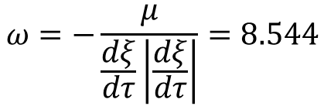

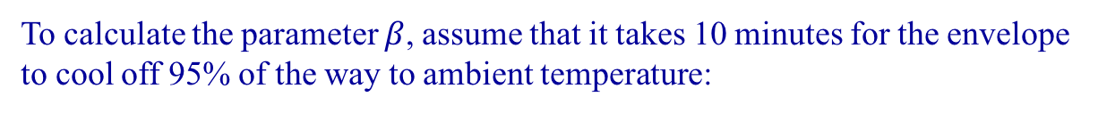





Example: AX7-77 Balloon Model Parameters
Hot Air Balloons were the first manned flying machines
To calculate the parameter $ω$, assume a free-fall velocity of -15 m/s:
$$ω=−\frac{μ}{\frac{dξ}{dτ}\left|\frac{dξ}{dτ}\right|}=8.544$$
To calculate the parameter $β$, assume that it takes 10 minutes for the envelope to cool off 95% of the way to ambient temperature:
$$β=−\frac{1}{\frac{τ_{c}}{t_{r}}}=0.01683$$
To calculate the scale factor $f_{r}$, assume that the fuel valve is set to 20% at takeoff:
0 $=−\left(θ_{i}−θ_{s}\right)β+Γ$
$$→$$
$$f_{r}=4870\%$$
To calculate the scale factor $p_{r}$, assume that with the fuel valve stuck wide open ($f=100\%$) the balloon can still stay on the ground if the vent valve is full open ($p=100\%$):
0 $=−\left(θ_{i}−θ_{s}\right)\left(β+Λ\right)+Γ$
$$→$$
$$p_{r}=1485\%$$

Slide 13
Example: AX7-77 Balloon
Hot Air Balloons were the first manned flying machines
As an example, let’s simulate the flight of a AX7-77 balloon from Head Balloons, Inc. [2]:
Carries pilot and two passengers
Envelope volume is 77,000 ft³ or 2180 m³
Maximum envelope temperature is 120 degC
Assume takeoff at STP (15 degC, 1 atm)
Sample loading from FAA flight manual supplement:
Envelope 225 lb
Basket 190 lb
4x10 gallon fuel tanks 280 lb
Pilot 170 lb
Passenger #1 125 lb
Passenger #2 165 lb
-------
Total 1155 lb or 523.8 kg

Slide 14


Hot Air Balloons were the first manned flying machines
Matlab Code: AX7-77 Balloon Model Numerical Solution
This example was implemented in Matlab (R2012b):
The ode is implemented in the function hab.m:
The simulation is performed in the script HotAirBalloon.m:

Slide 15
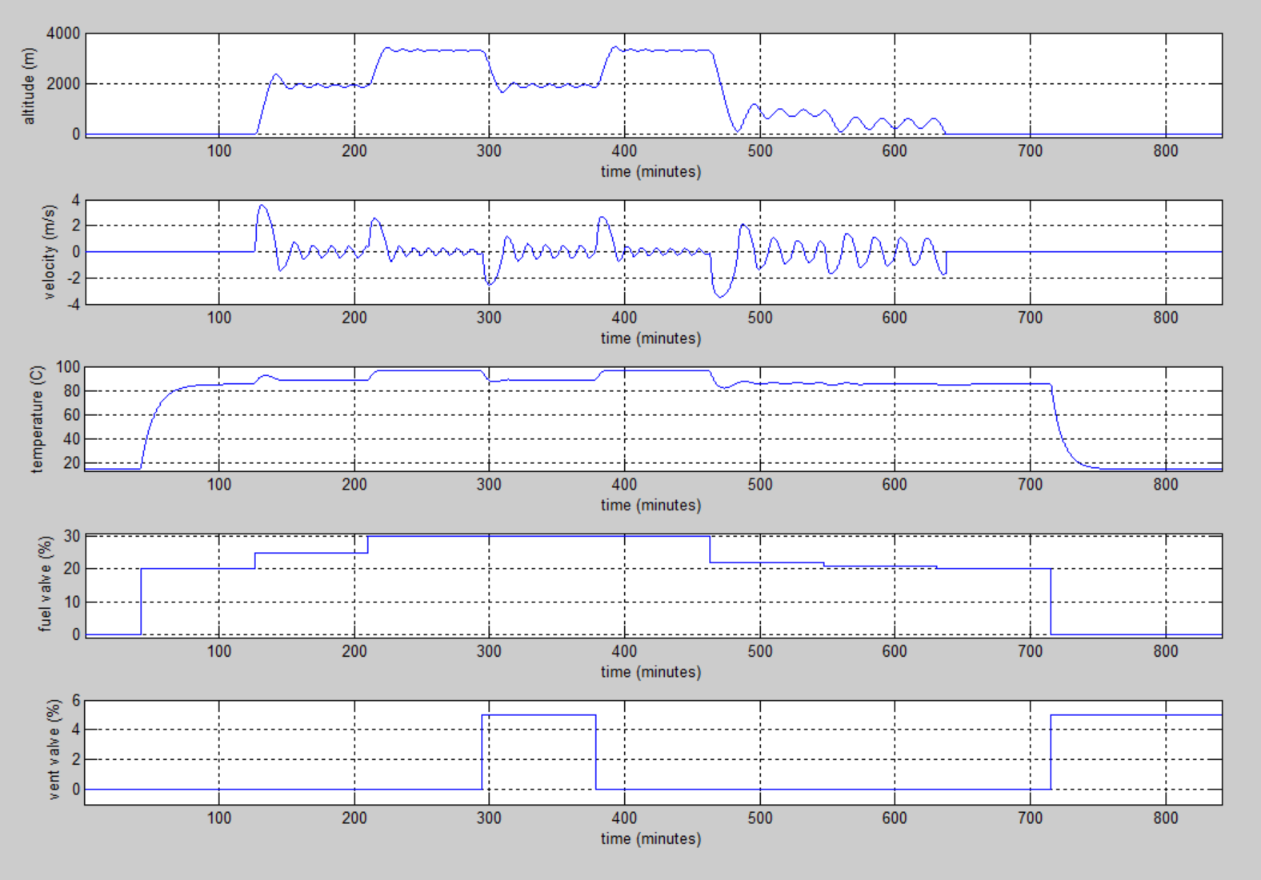
Hot Air Balloons were the first manned flying machines
Simulation Results: AX7-77 Balloon Flight
Fuel valve opens and bag warms up
Bag initially at ambient temperature
Vent opens up and balloon drops
Less fuel and balloon descends
Less fuel and balloon descends
Bag reaches takeoff temperature
Less fuel and balloon lands
Balloon levels off and oscillates
More fuel, balloon goes higher
Vent closes and balloon rises
On ground; shutoff fuel, open vent
More fuel causes balloon to takeoff

Slide 16
Hot Air Balloons were the first manned flying machines
References
[1] John D. Anderson, Introduction to Flight, McGraw-Hill, (1978).
[2] FAA Approved Balloon Flight Manual Supplement for Head Balloons, Inc. Model AX7-77 w/Parachute Top (1984).

